Slide 1
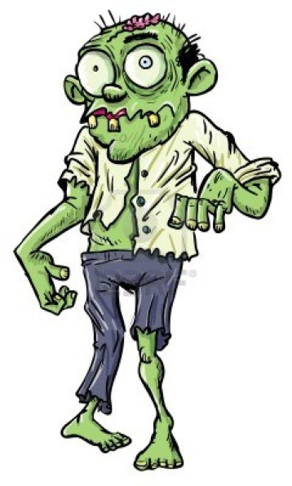
Bell Work
A ZOMBIE APOCALYPSE!!!
Please walk in Silently . Stop by the pick up table and get started on your bell work.
Kate Bond is being attacked by zombies. In a complete sentence, write down what kind of super power would help you to survive the zombie attacks. Please explain why or how that super power would help you survive!

Slide 2
So WHY? Are we talking about zombies and superpowers!?!?!?!

Slide 3
Objective
Today we will
Compare and Contrast structural and behavioral adaptation
Analyze how structural and behavioral adaptations allow organisms to be better suited for their environment
Create our very own organism that would be best adapted to the environment

Slide 4
Agenda
Bell work
Reading Notes
Guided Practice: What kind of adaptation allow these animals best fit for the environment?
Independent work: Create an animal that will be best adapted to the environment.
Exit Ticket

Slide 5
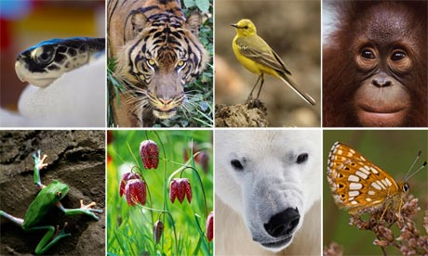
Connecting Question
Biodiversity is important, we already know that. But where does this “VARIETY” of “LIVING” things come from?

Slide 6
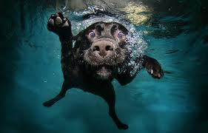
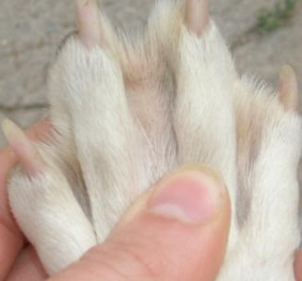
Variation: Differences between individuals
Labrador
Daschund

Slide 7
Adaptations are traits that improve an organism’s chance to survive and reproduce in a certain environment
Structural Adaptation
Behavioral Adaptation
inherited traits of body structure or physical appearance that helps an organism to survive
helpful inherited behaviors that increase the likelihood of an animal surviving to reproduce

Slide 8
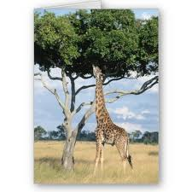
Structural
Behavioral
https://www.youtube.com/watch?v=t-LTWFnGmeg

Slide 9
Brainpop

Slide 10
Guided Practice:
For each slide, work in your groups to answer the following questions.
What kind of organism is it?
What kind of adaptations does this animal have?
Is it structural or behavioral?
How does it benefit the organism?

Slide 11
Things to think about
Where does it live?
What kind of food does it eat?
What kind of organisms eat IT?
Can you think of any others?

Slide 12
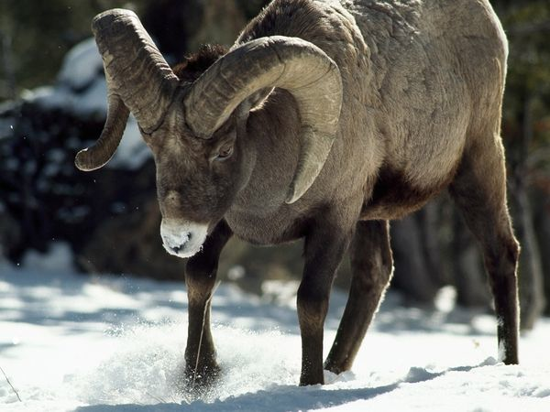
List the adaptations most needed for survival

Slide 13
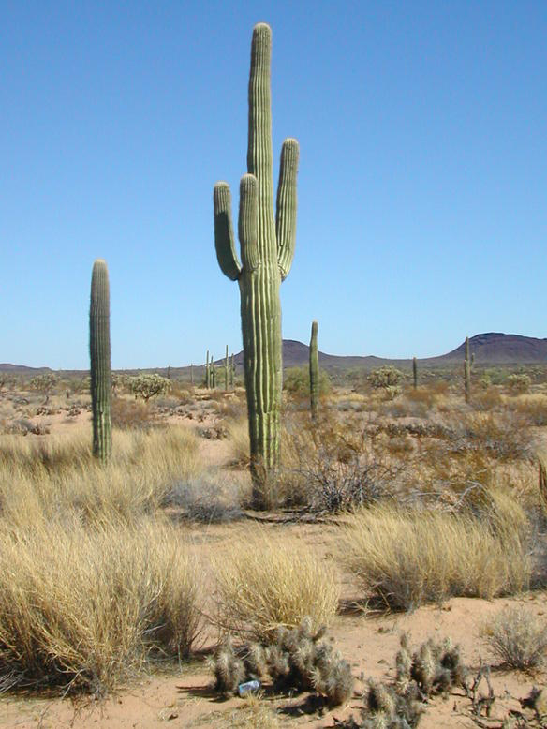
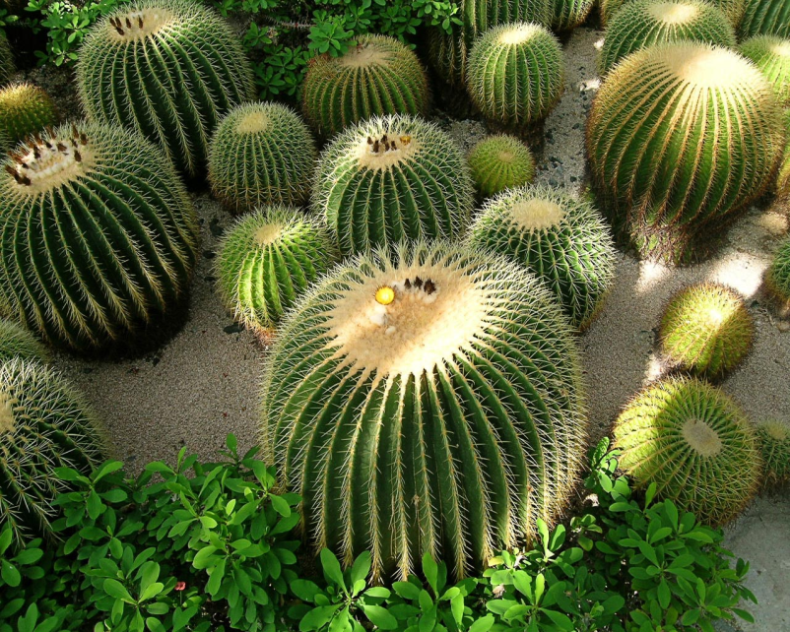
List the adaptations most needed for survival

Slide 14
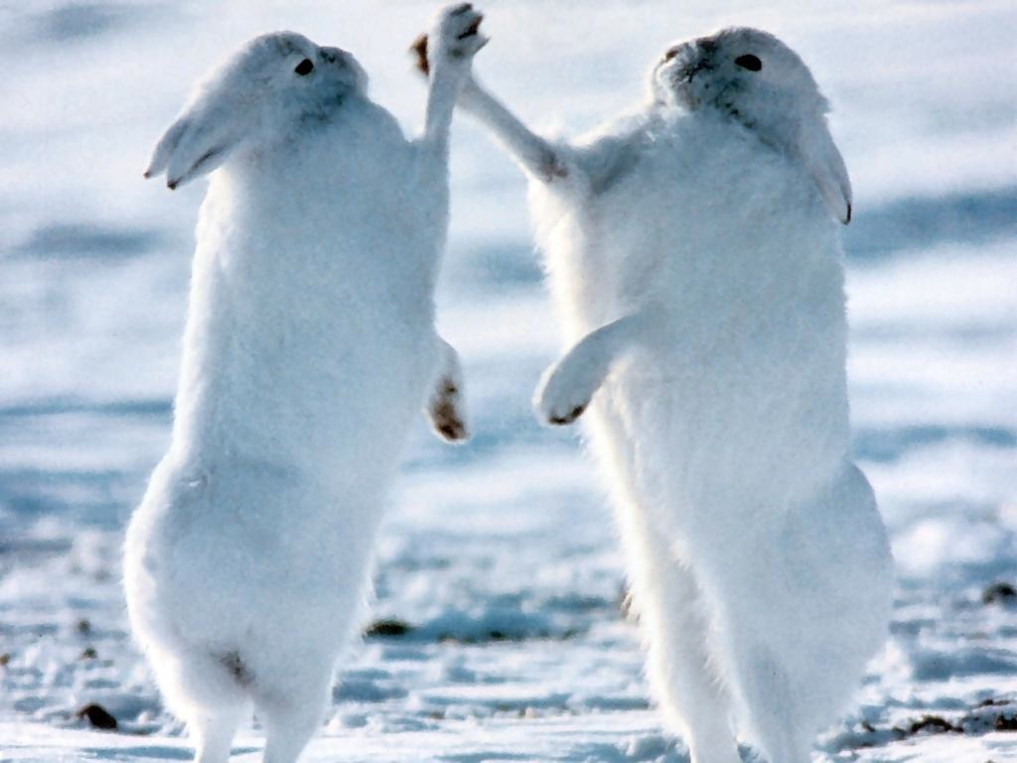
List the adaptations most needed for survival

Slide 15
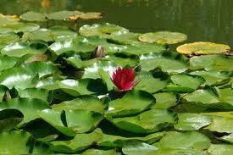
Lily pads

Slide 16
Let’s Check! 2 minutes to answer these questions independently.
1.) Great white sharks sneak up on a school of fish from underneath. Is this a behavioral or a structural adaptation?
2.) Write down one example of an adaptation that a shark has. Describe how it allows it to better survive in its environment.

Slide 17
Independent Practice
On the center of your tables are picture of different environments.
Objective: Create an organism of your own that will be best adapted to the environment. Explain the types of behavioral and structural adaptations that the organism has and how it helps the organism to survive.

Slide 18
Exit Ticket: Tear and Share
1 piece of paper per table.
Tear it NEATLY for each person at the table.
Write your name, date, period on the top.
Answer all questions in complete sentences!

Slide 19
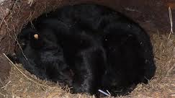
List the adaptations most needed for survival
Bears hibernate during the winter to when food supply is low.
1.) Is this a structural or behavioral adaptation? What is the benefit of this adaptation?
2.) Write down one example of an adaptation that a shark has. Describe how it allows it to better survive in its environment.

