Slide 1
Bellwork
Please walk in Silently and begin your bellwork. All questions must be answered in complete sentences.
1.) Describe structural adaptations.
2.) What are behavioral adaptations?
3.) Choose an organism. Describe its structural and behavioral adaptation.

Slide 2
Agenda
Bellwork
Objective: SWBAT evaluate and debate in what kind of an environment an organism is most adapted to.
Introduction to ADAPTATIONS PROJECT.
Debate and Challenge.

Slide 3
Adaptation Projects
DUE DATE: February 21, 2014
Objective: Create an imaginary creature that have both structural and behavioral adaptations that allow it to survive in a particular environment.
Create an “illustration” along with a expository essay that illustrates and describes the adaptations the imaginary organism has to survive in its habitat

Slide 4
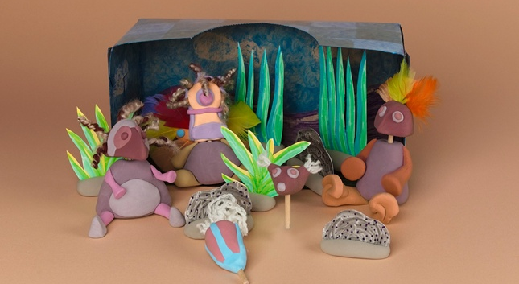
Diorama

Slide 5
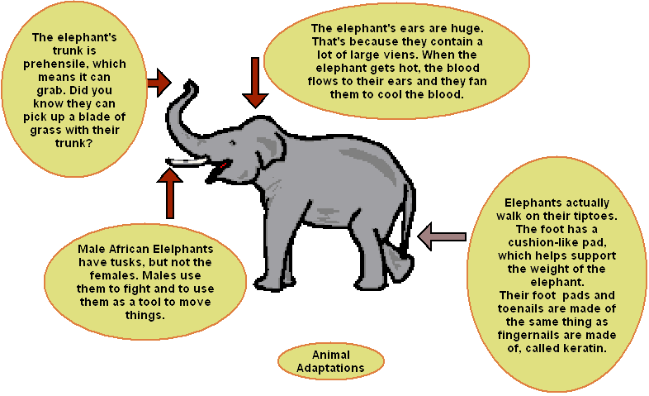
Poster

Slide 6
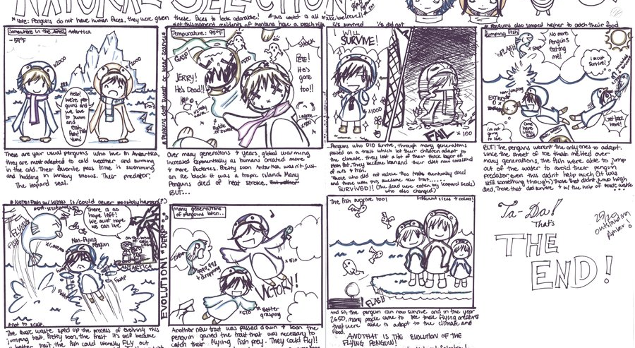
Comic Strip

Slide 7
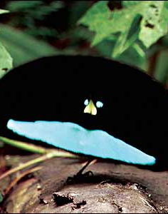
Superb Bird of Paradise
Describe this bird’s STRUCTURAL ADAPTATION.
What are its BEHAVIORAL ADAPTATIONS?

Slide 8
The Great Debate!
We have just discovered a new species and need to bring it to the the MEMPHIS ZOO!
The problem is, we need to recreate its habitat for it to survive in the zoo.
Your job is to take note of the new species’ adaptations and describe what kind of environment the animal is adapted to.
Each group will be assigned a specific environment. Each group will send one speaker to represent the ideas from each group.

Slide 9
Debate format
You are scientists.
- Use scientific language
- Use details and be specific supporting evidence
-Be respectful but convincing

Slide 10
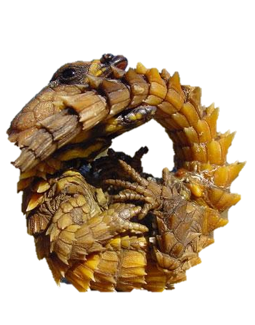
Dragon Lizard
Desert or Forest
Savannah?

Slide 11
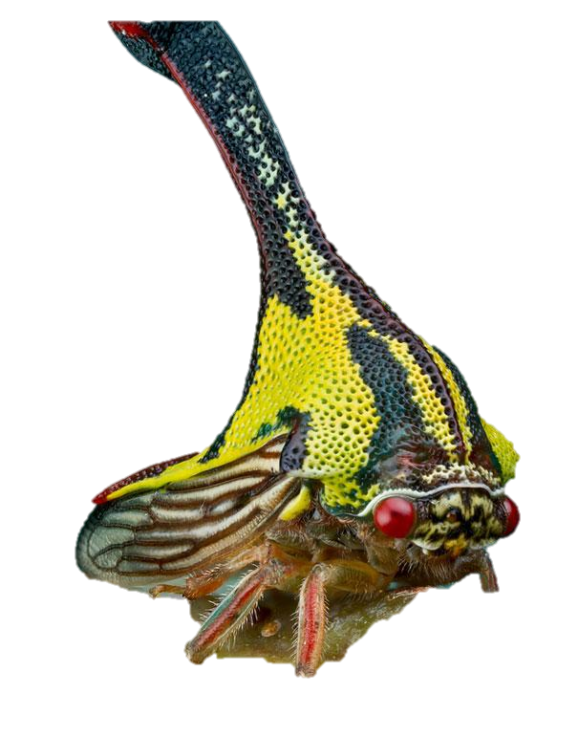
Umbonia Spinosa
Rainforest or Savannahs
Or Desert?

Slide 12
Independent Practice
EXTEND! What you’ve already learned about adaptations so far and find out about other examples of BEHAVIORAL and STRUCTURAL ADAPTATIONS.

