Slide 1
Bell work 2.6.14
What do you think biodiversity is?
H₂ + 2Cl → 2HCl
2. What are the reactants in the chemical equation above? Products?
3. If you have 20 grams of product, how many grams of reactant did you start with?

Slide 2
Agenda
Bellwork
Objective: SWBAT define biodiversity and explain the need to preserve biodiversity in our environment.
Brainpop
Reading Notes
Projects Coming up!

Slide 3
Brainpop
https://www.youtube.com/watch?v=N5ssjM2Fjuc
https://www.youtube.com/watch?v=kHhspf5IfdE *****
https://www.youtube.com/watch?v=V1VYmpTikgw

Slide 4
Questions we will answer today
What is biodiversity?
Why is biodiversity important?
What are some threats to biodiversity?
How can we preserve Biodiversity?

Slide 5
Notes Setup
What is biodiversity? | Why is biodiversity?
What are some threats to biodiversity? | What can we do to preserve biodiversity?

Slide 6
Reading Notes!
As you read the article, fill out our biodiversity notes!

Slide 7
What is biodiversity?
What words do you see in biodiversity?

Slide 8
Life
Bio =
Diversity = Variety
Biodiversity is different kinds of life in an ecosystem
Greater biodiversity in an area keeps the ecosystem in balance

Slide 9
Biodiversity increases ecosystem stability for a given type of ecosystem.
If an ecosystem is very diverse, than the ecosystem will not suffer too much if one species goes extinct (which means the species no longer exists)
Humans cannot recreate the things provided by the diverse organisms of the Earth.

Slide 10
What are some things we get from biodiversity?

Slide 11
What do we get from biodiversity?
Oxygen
Food
Clean Water
Medicine from plants
Ideas
Clothes
Places to live

Slide 12
Why is biodiversity being threatened?

Slide 13
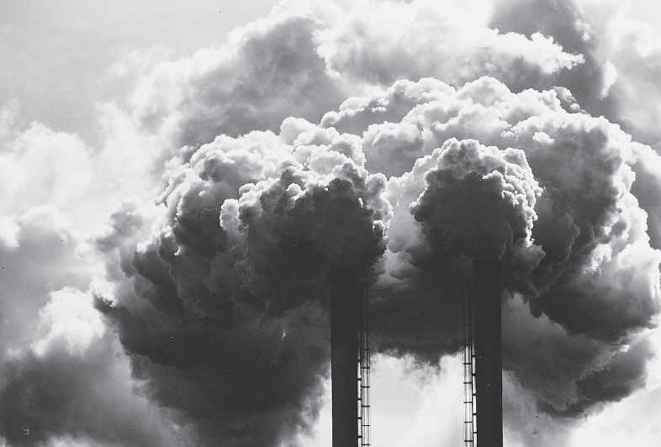
Threats to Biodiversity
HUMANS are on of the greatest threats to biodiversity:
The destruction of plant and animal habitats by humans
Pollution in any form can be harmful to biodiversity

Slide 14
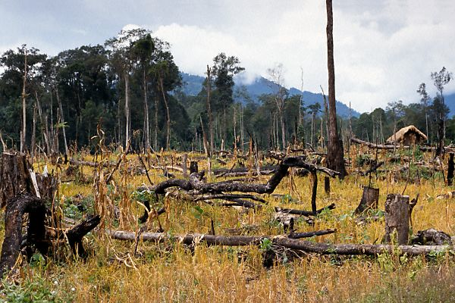
Threats to Biodiversity
Deforestation is the destruction of plants or trees

Slide 15
What is the reason why humans use deforestation?

Slide 16
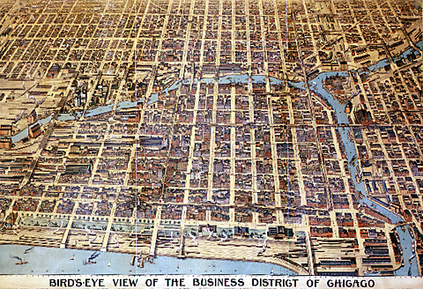
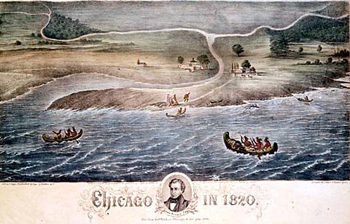
Benefits of Deforestation-Urbanization
Urbanization refers to a process in which an increasing proportion of a entire population lives in cities

Slide 17
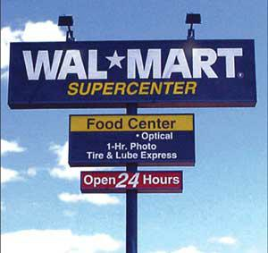
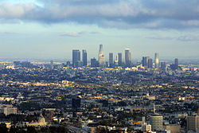
Benefits of Deforestation-Urbanization
This allows space for shopping malls, homes, other buildings, etc.

Slide 18
What are some CONSEQUENCES of deforestation?

Slide 19
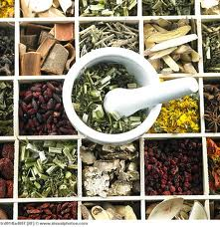
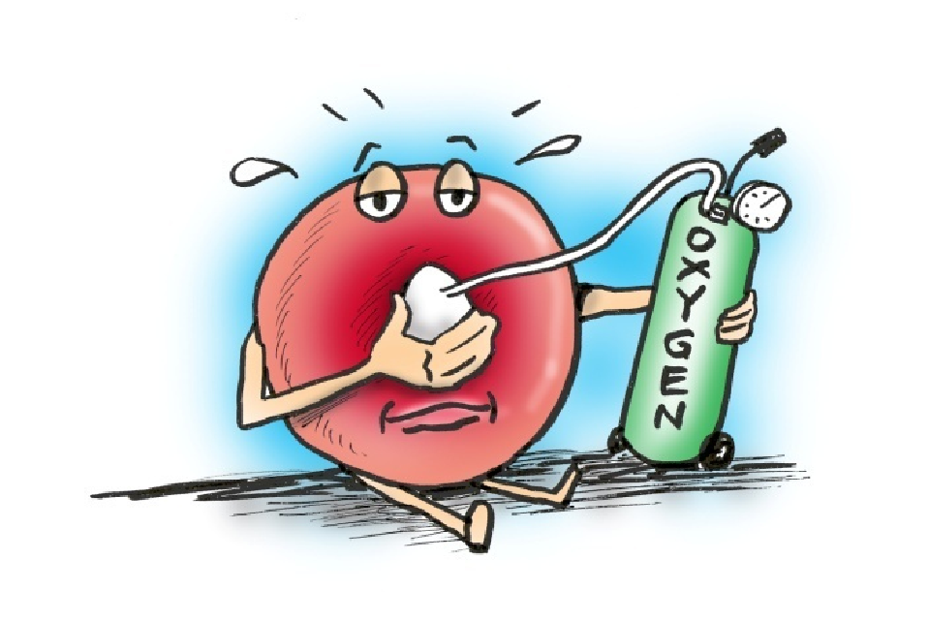
Consequences of Deforestation
Loss of habitat for animals which results in
a disruption of food chain/web
loss of animal biodiversity
Loss of beneficial plant products such as medicines
Decrease in the amount of available oxygen in the atmosphere for humans to breathe

Slide 20
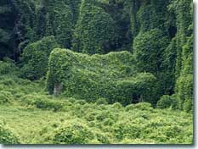
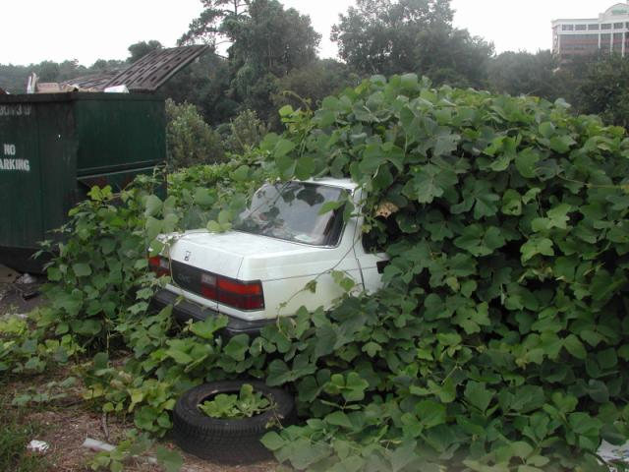
Threats to Biodiversity
The introduction of non-native (invasive) species that outcompete native ones
Notes:
Kudzu-native to China and Japan

Slide 21
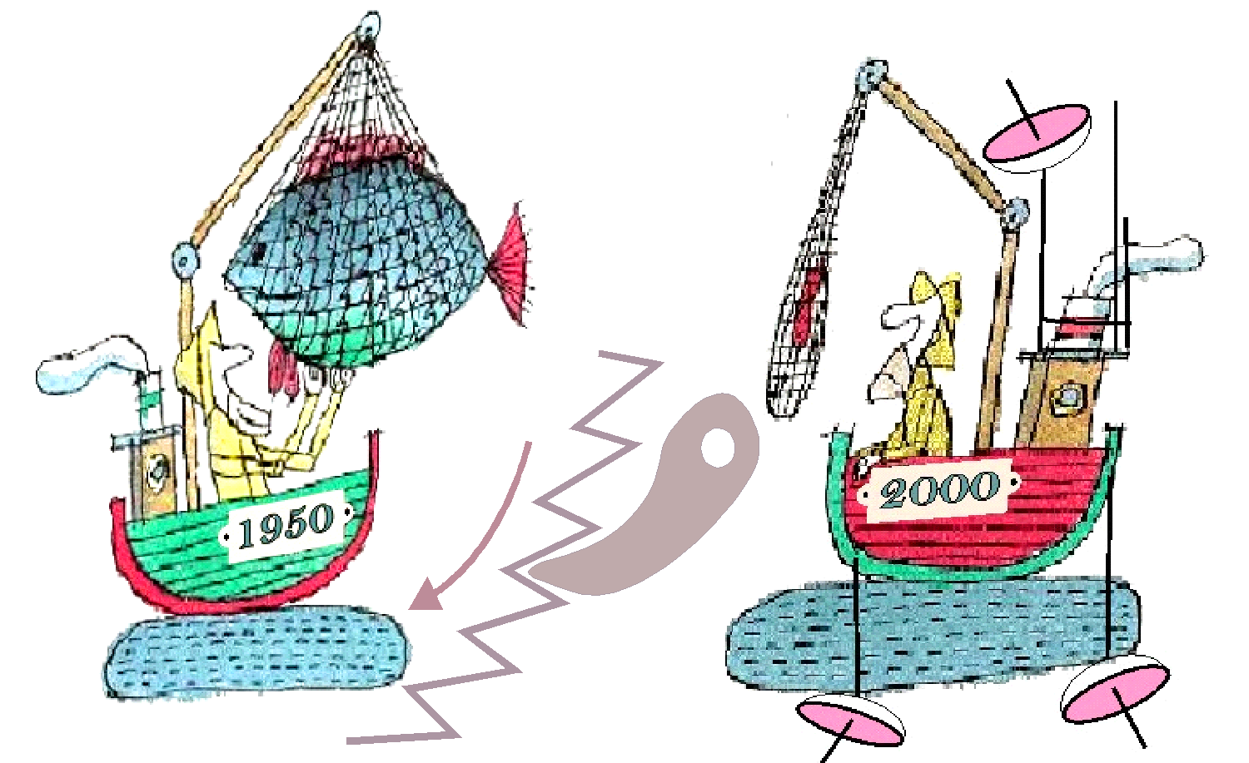
The over-exploitation (over-hunting, over-fishing, or over-collecting) of a species or population can lead to its demise or downfall.

Slide 22
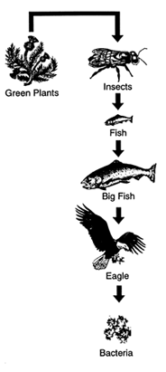
Disruption to the Food Chain
This can ultimately result in a loss
of resources for us!

Slide 23
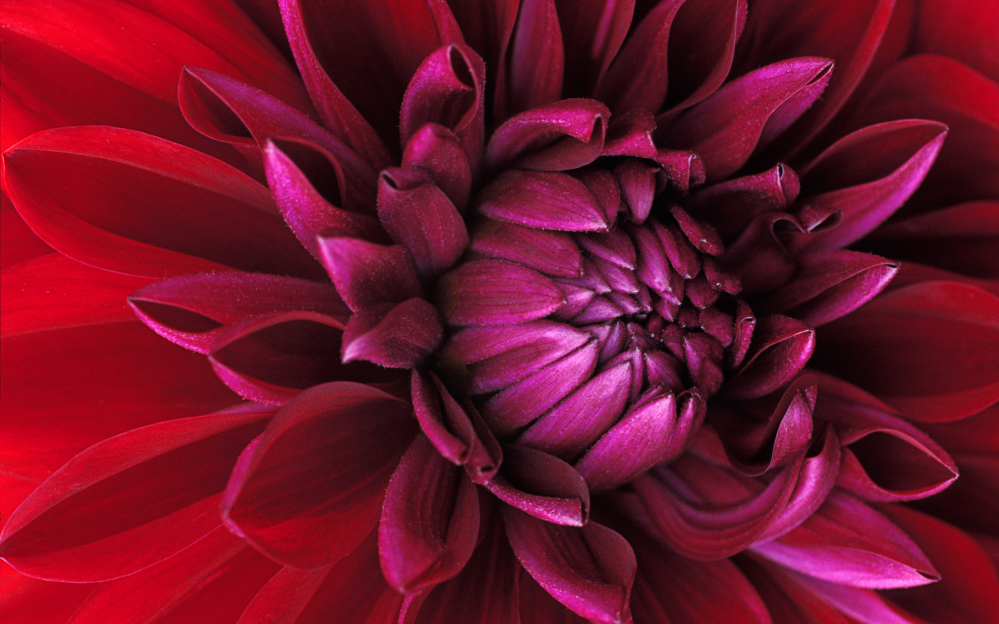
When Biodiversity is Decreased…
Everything in the environment is affected!

Slide 24
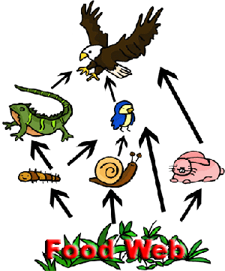
Quick Question!
What happens if there are no lizards?

Slide 25
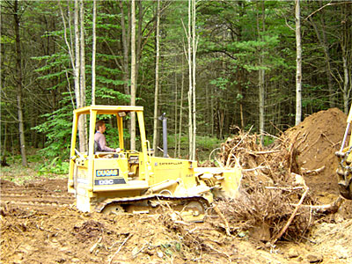
How would this lead to a decrease in biodiversity?

Slide 26
Independent practice
Create a newspaper article below or on a separate sheet of paper based on the following scenario:
Congratulations! You are a world-famous, genius science researcher! Everyone knows your name since you cured cancer, AIDS, and the hiccups within a few short years. Even though you are not a famous millionaire, you still enjoy answering basic science questions for the younger generations so you have a column in the Commercial Appeal. Below is this week’s question. Read and respond to it based on your knowledge of biodiversity and its importance in our ecosystem.

