Slide 1
Bellwork
Please walk in Silently. Sit at your table number you sit at in class. If your table is full, please sit at table 7.
Please do not touch any of the lab material until given permission.
Read the introduction for the lab and answer the prelab questions.

Slide 2
Prelab Questions
Purpose: The purpose of the lab is to categorize substances as ____________________ or ______________________ by observing their reaction with the _______________________ indicator.
PRELAB QUESTIONS
What is a pH indicator?
In this lab, what is the molecule that is used as a pH indicator?
Describe the properties of an acid.
Describe the properties of a base.

Slide 3
Agenda
Bellwork : Prelab Questions
Objective: SWBAT conduct and experiment using a pH indicator to classify substances as an acid or a base.
Purpose : What is our goal for today? Why are we doing this lab? What do you want to learn today?

Slide 4
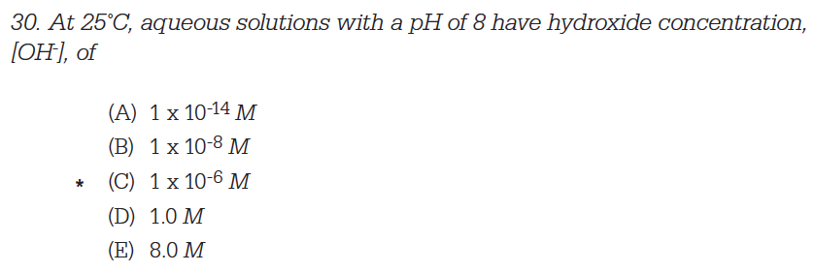
Looking Ahead!

Slide 5
Lab Set up
Independent Variable : What are we changing or testing?
The independent variable is the different substances that we are testing.
Dependent Variable : What are we measuring or observing?
The dependent variable is the color that the solution changes into
Hypothesis: (If… then… because…. )

Slide 6
Use the chart below to write your hypothesis.
If the substance is an acid, then the ph indicator will…… because …..
If the substance is a base, then the pH indicator will ….. because…

Slide 7
Please pay attention to Ms. Kim’s demonstration.
Make QUALITATIVE OBSERVATIONS
Make a prediction
Test
****Read the Lab Rubric! ****

Slide 8
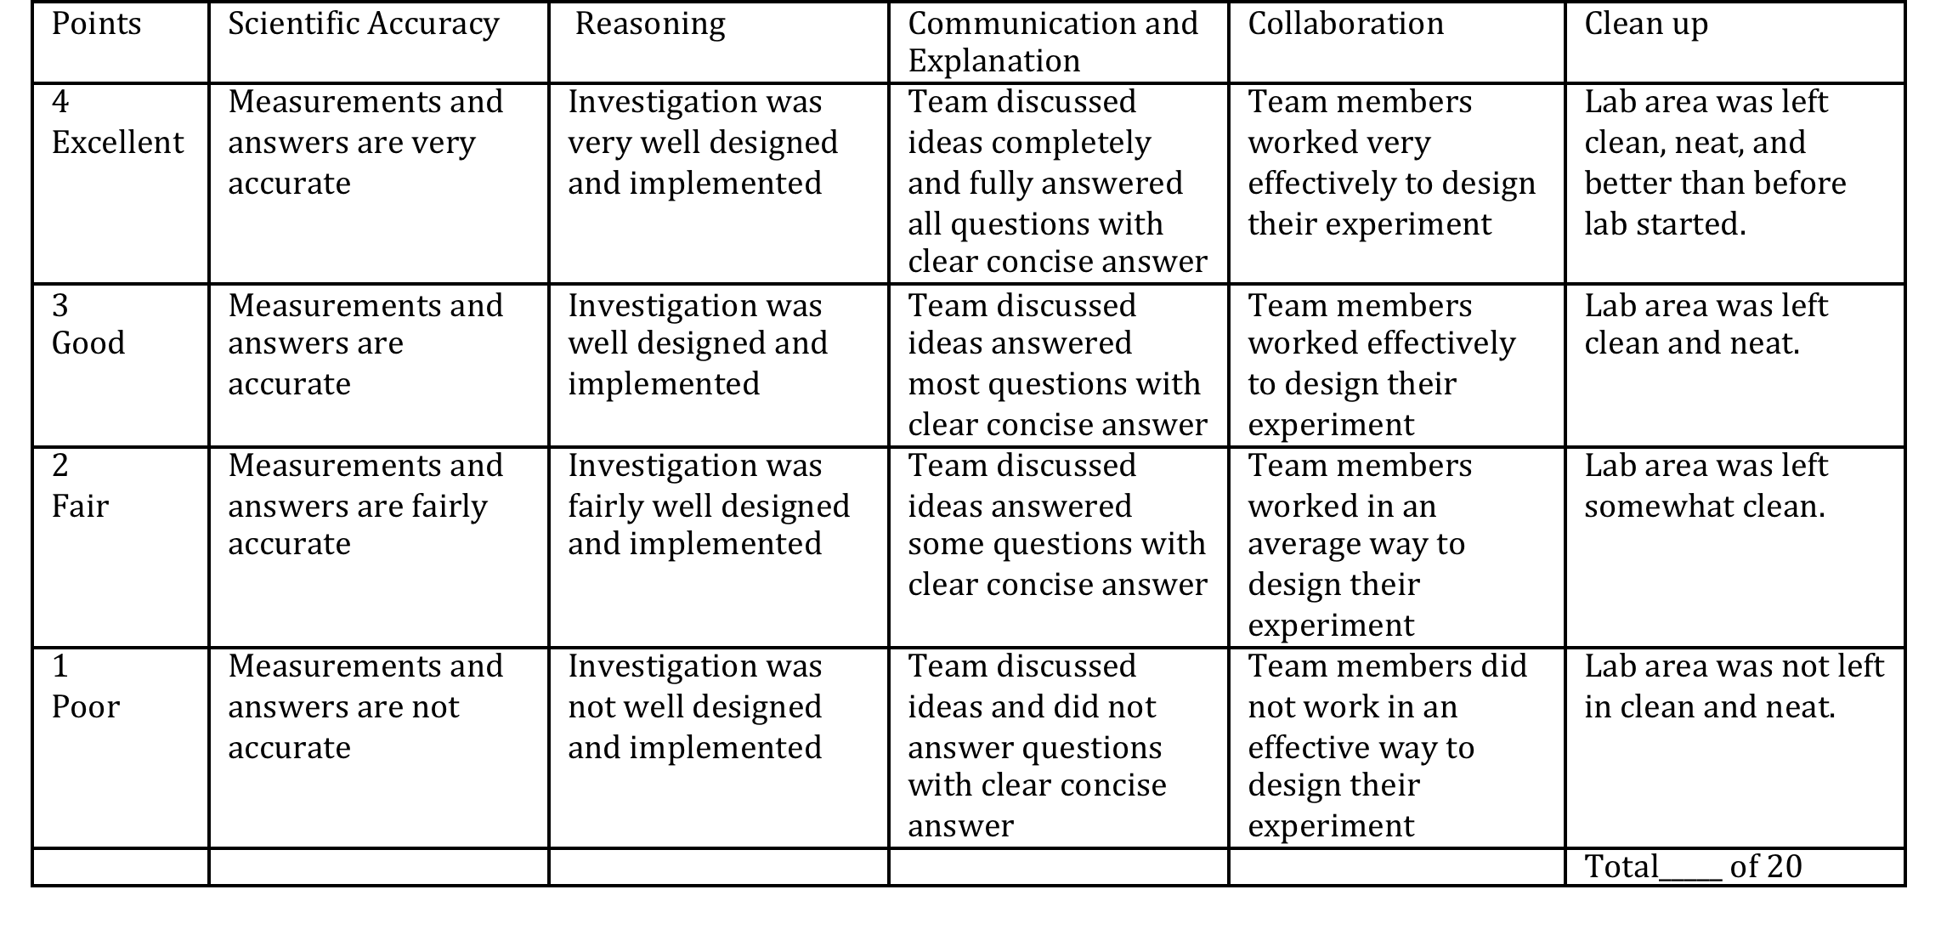
Lab Rubric!!!

