Slide 1
Bellwork 12.9.14
Please walk in Silently and begin Bellwork.
1.)
2.)
3.)
Write Down your homework.

Slide 2
Agenda
Bellwork
Objective: Students will be able apply the Law of conservation of mass by counting the number of atoms of an element and balancing chemical equation.
Brianpop
Key Points
Guided Practice
Independent Practice

Slide 3
BrainPOP!

Slide 5
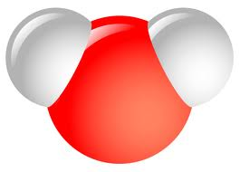
Chemical Formulas
Show us how many/what types of atoms in a molecule
Parts:
Chemical symbols – tell what atoms are involved
2H₂O

Slide 6
Chemical Formulas
Show us how many/what types of atoms in a molecule
Parts:
Chemical symbols – tell what atoms are involved
Subscripts – small #s, tell how many of a particular atom
2H₂O

Slide 7
Chemical Formulas
Show us how many/what types of atoms in a molecule
Parts:
Chemical symbols – tell what elements the atoms are
Subscripts – small #s, tell how many of a particular element are present
Coefficients – big #s, tell how many molecules
2H₂O

Slide 8
Counting Atoms
1) Write down all of the elements
Remember: Elements have a chemical symbol made of 1 capital letter or 1 capital and 1 lowercase letter
2.) Circle the subscript for each atom
This tells you how many atoms you have
3.) Underline the Coefficient. Multiply each of the subscripts by the Coefficient to get the total number of atoms of an element.

Slide 9
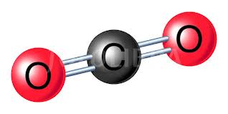
CO₂
_{C=}
O
2CO2
C=
O =
1

Slide 10
Guided Practice
CH₄
What elements?
C= Carbon
H = Hydrogen
How many C?
How many H?

Slide 11
Guided Practice
Pb(NO₃)₃
What elements?
Pb
N
O
How many Pb? 1
How many N? 1 x 3 = 3
How many O? 3 x 3 = 9
1
1

Slide 12
How many of each type of atoms are in the following chemical formulas…
C₆H₁₂O₆
3ZnSO₄
2Al₂O₃
3H₂O
C | H | O
Zn | S | O
Al | O
H | O

Slide 13
Exit ticket
Count the number of atoms in this reaction
3ZnS₄O → 3Zn + SO₄
1.) How many Zn are in the Reactants?
2.) How many Zn in the produts?

