Slide 1
Bellwork : January 6, 2014
Please walk in Silently. Stop by the pick-up table.
All bellwork questions should be answered in complete sentences. Please make sure to write the date and number all questions.
1.) What are 3 goals that you have set for yourself for 2014?
2.) Imagine you are in the year 2034 (20 years from now). How old will you be? What will your job be? What will you have accomplished in that time?

Slide 2
Agenda
Bellwork
Objective:
SWBAT to identify the reactants and products in a chemical reaction.
SWBAT to identify the common outcomes of all chemical reactions
Physical vs. chemical changes RECAP!
Guided Practice
Independent Practice.

Slide 3
Announcement
How many of you have internet at home?
How many of you use Facebook?
www.MsKimsScience.weebly.com

Slide 4
Write it down. Memorize it. Use it.
www.MsKimsScience.weebly.com
www.MsKimsScience.weebly.com
www.MsKimsScience.weebly.com
www.MsKimsScience.weebly.com
www.MsKimsScience.weebly.com
www.MsKimsScience.weebly.com

Slide 5
Video Introduction
https://www.youtube.com/watch?v=gCbqjs-pqJo
https://www.youtube.com/watch?v=Zsi-_zOtzzk
Brainstorm: Why would we need to learn about chemical reactions? What are some examples of chemical reactions in everyday life?

Slide 6
Physical vs. Chemical Change Review
Physical Change
Chemical change

Slide 7
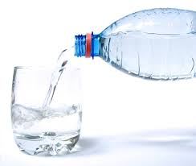
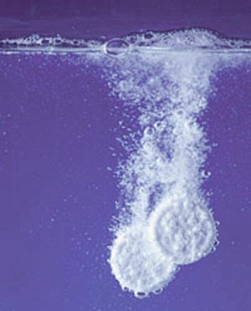
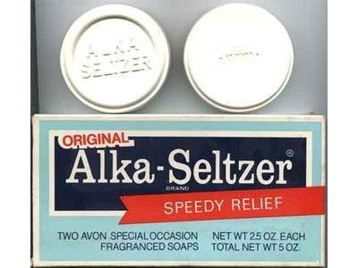
Common Outcomes of all Chemical Reaction
#1 Chemical reactions always create a new substance or new composition.

Slide 8
“Composition”
→ Compose, Composer
→ To make up something

Slide 9
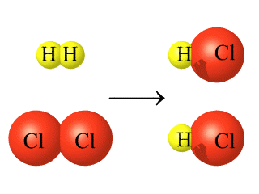
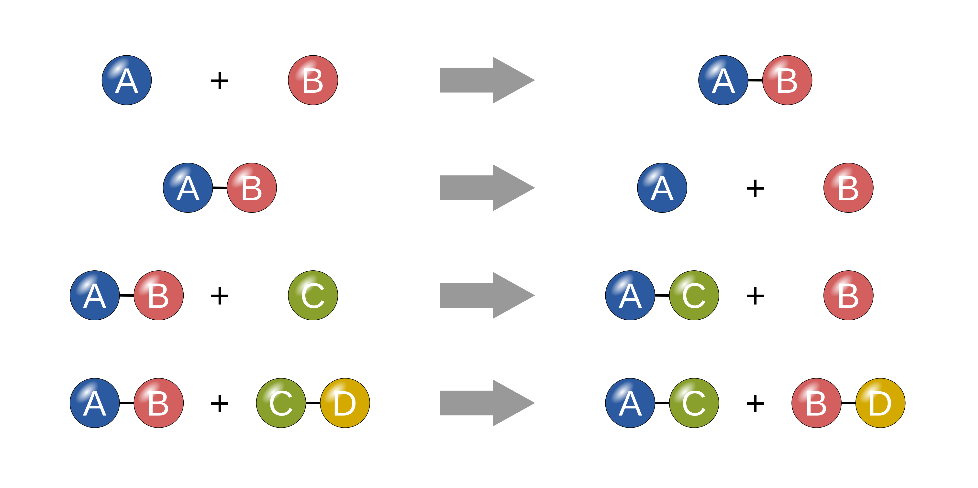
Common Outcomes of all Chemical Reaction
#2 New Chemical Bonds are formed

Slide 10
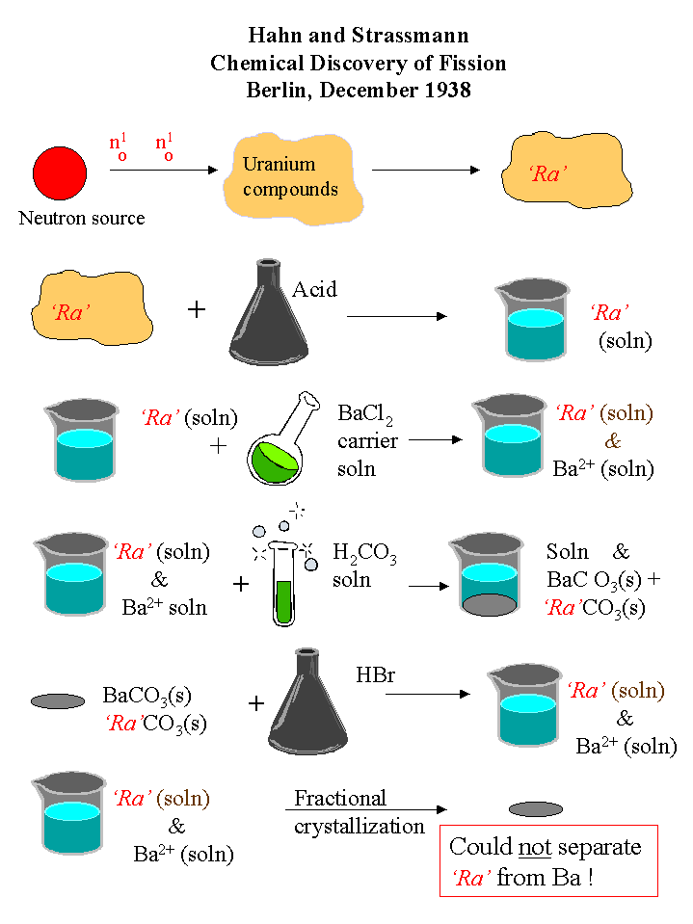
Common Outcomes of all Chemical Reaction
#3 New Chemical Properties

Slide 11
Common Outcomes of all Chemical Reaction
#4 Chemical reactions are ALWAYS CHEMICAL CHANGES!

Slide 12
Guided Practice: How do you know?

Slide 19
Exit Ticket

