Slide 1
Bell work 2.25.14
You are the manager of a grocery store. You have a list of new produce in and your job is to make sure that your organize them for your customer. (spinach, tomatoes, potatoes, onions, cereal, pasta, pasta sauce, etc.)
1.) How would you organize the produce?
2.) Why would you need to organize the produce?
3.) How would you classify living things?

Slide 2
Agenda
Bell work
Objective: SWBAT define key words that relate to classifying organisms.
Homework
Cornell notes for Vocab
Tim and Moby
Notes
Classwork

Slide 3
Guiding Question
There are so many types of animals with different adaptations.
Why would we need to categorize and organize them?
How do we organize and categorize them?

Slide 4
Word Scramble
At the center of your table, you have different strips of paper either with a word, or definition.
You have 5 minutes to match the words with their definitions with your group

Slide 5
Expectations
Group work expectations?
6 inch voices
Everyone is working together
Time limit

Slide 6
TAXONOMY
The science of identifying, classifying, and naming living things

Slide 7
Week 23 Weekly Words
MORPHOLOGY
An organism’s structure

Slide 8
Week 23 Weekly Words
Binomial Nomenclature:
(bi NOH mee ul – NOH mun klay chur)
A two word naming system used to name organisms

Slide 9
Week 23 Weekly Words
SYMMETRICAL
Exactly similar parts facing each other

Slide 10
Week 23 Weekly Words
PHYLOGENY
(fi LAH juh nee)
The evolutionary history of an organism

Slide 11
Well, why do I care about these words?
Let’s ask Tim and Moby

Slide 12
Intro to Biology
But even so, we wouldn’t look for green apples next to the potatoes.
We know to look in the fruit section, but it gets even more specific than that. Apples have their own section, and even there they are divided up by color and type.
food
Fruit
Dairy
Meat
Bread
Fats/sugar
vegetable
Orange
Banana
Grapes
Apple
Red
Yellow
Green
Granny Smith
Empire

Slide 13
Intro to Biology
This is the challenge that we (scientists) face.
There are more than 3,000 quintrillion living things on planet Earth.
Just like we classify apples into smaller groups to make the easier to find, scientists must classify living things into smaller groups in order to find and share information easily.

Slide 14
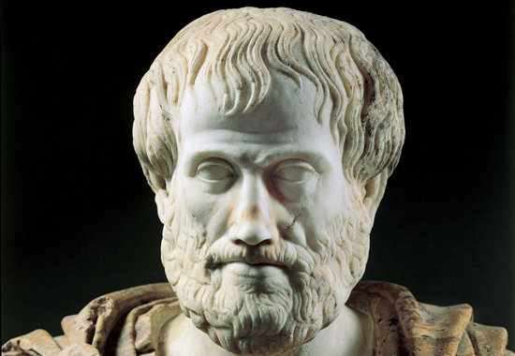
Intro to Biology
Once upon a time, a long long time ago, this bro named Aristotle got his act together and decided to classify living things. In other words, he created a taxonomy of living things.

Slide 15
Intro to Biology
It’s not that hard …. I mean, we have plants, and we have animals. Two groups.
DONE AND DONE!

Slide 16
Intro to Biology
If you wanna get all picky, then I’ll sort them a little more. Animals that fly, animals that walk, animals that swim.

Slide 17
2,000
years later

Slide 18
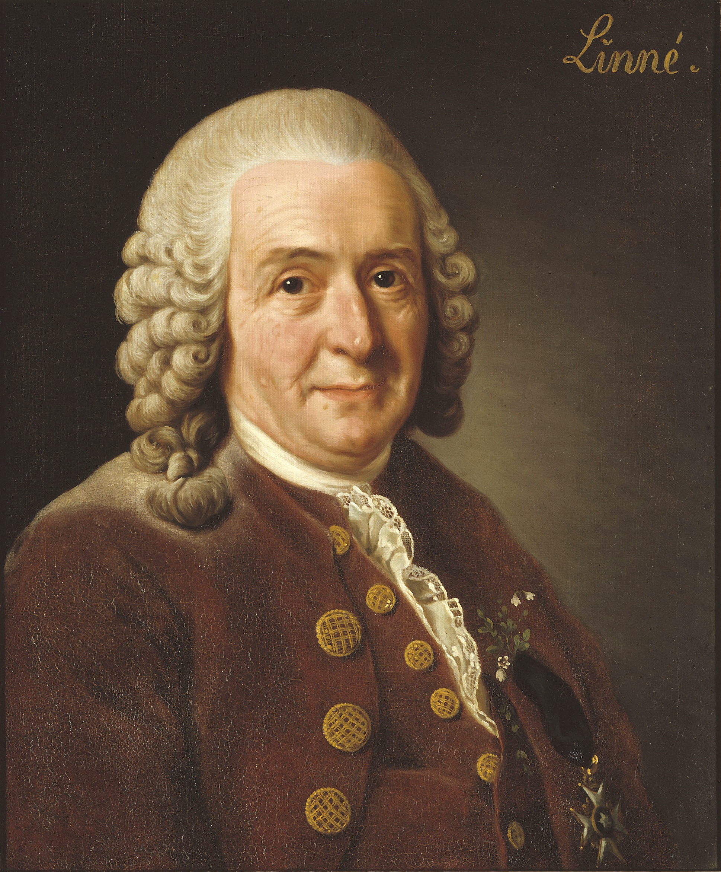
Intro to Biology
Hey Bro, I don’t know if you heard, but I’m Carolous Linneaus…. And I kind of OUT DID your little “classification”

Slide 19
Intro to Biology
I group organisms based on their MORPHOLOGY and classify them into different levels

Slide 20
Intro to Biology
I’m SLIGHTLY more advanced, but don’t get all bummed on yourself. You cool.

Slide 21
TODAY
So, Linneaus was a pretty smart dude and we still use his system of classification today.
Scientists still use traits to distinguish between two organisms.
Example: mammals feed their offspring with milk and they have fur

Slide 22
Think Pair Share
Think. : What was aristotle’s way of classifying organisms?
How was it different from Linnaeuss’ way of classifying organisms?
Pair and Share: Tell a friend

Slide 23
What Are the Levels of Classification?
There are many groups that living organisms fit into.
Scientists split these groups into 7 levels:
Species
Genus
Family
Order
Class
Phylum
Kingdom

Slide 24
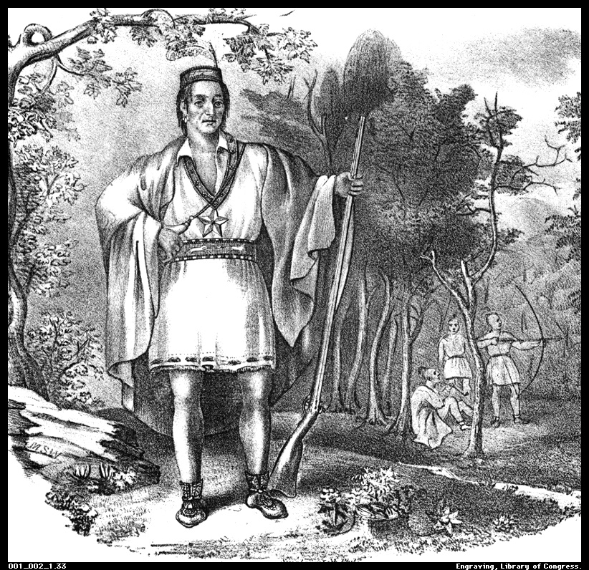
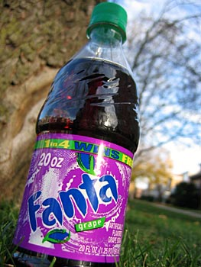
How to Remember All of Those in Order
King
Phillip
Came
Over
For
Grape
Soda

Slide 25
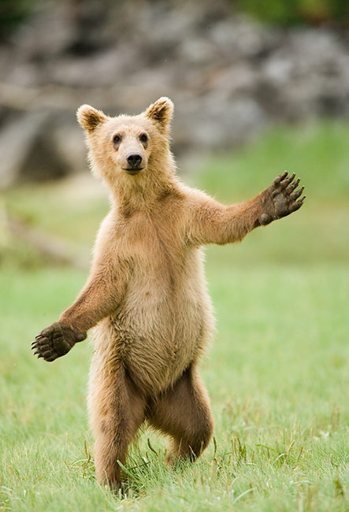
Classification of a brown bear
Kingdom: Animal
Phylum: Chordata (backbone or not?)
Class: Mammalia (does it have hair?)
Order: Carnivora (what does it eat?)
Family : Ursidae (bear family)
Genus: Ursus (Is its fur just one color?)
Species: Ursus arctos (brown bear)

Slide 26
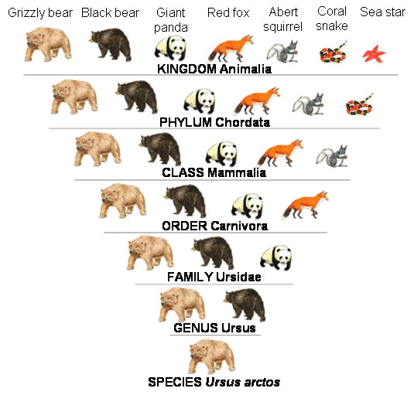
Intro to Biology

Slide 27
Binomial Nomenclature
The scientific name of an organism has 2 parts (“bi” means 2)
Just like our names have our First Name and Last name, scientific names of organisms are made up of is Genus name and species name.
Usually italicize or underlined

Slide 28
For example,
The scientific name for humans is
Homo sapiens
Genus species

