Slide 1
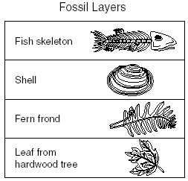
Bellwork
Please walk in SILENTLY. Stop by the PICK UP table. Get started on your bell work.
Describe Aristotle’s method of classification.
Describe Carolous Linneaus’ method of classification.
What are the 7 levels of classification?
Based on the diagram below, which is the oldest fossil?
Which is the youngest fossil?

Slide 2
Agenda
Bell work
Objective: SWBAT use a dichotomous key to classify organisms based on their morphology.
Notes
Using the Dichotomous key to identify POKEMON!
Try it on your own/ Homework

Slide 3
Review: What is Classification?
Classification: the arrangement of organisms into orderly groups based on their similarities
Vocab Check!
____________ is the classification of living things .

Slide 4
What is Classification?
Classification: the arrangement of organisms into orderly groups based on their similarities
Taxonomy is the classification of living things .

Slide 5
Has this ever happened to you?
A: Hey, do you know Justin?
B: Which Justin?
A: The singer
B: I know! Which one? The one with the blue eyes or the one with the brown eyes?
A: The one with blue eyes.
B: Yeah, I know Justin Timberlake

Slide 6
Why Do Scientists Classify Organisms?
To group species based on similarities and differences
To know the characteristics that exist for each species
To see how organisms are related

Slide 7
Dichotomous Key
A dichotomous key is a tool that allows the user to determine the identity of items in the natural world such as tress, wildflowers, mammals, reptiles, butterflies, etc. Keys consist of a series of choices that lead the user to the correct name of the given item.

Slide 8
“Dichotomous”
“Dichotomous” means “divided into two parts”
Therefore, dichotomous keys always give two choices in each step.

Slide 9
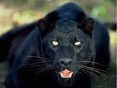
Scientific Questions
What would be a good question to ask to distinguish between these two felines? Remember, the question has to help me separate these two organisms!

Slide 10
Steps for Using Dichotomous Keys
1. Always read both choices.
2. Be sure you understand the meaning of the terms involved.
3. After you arrive at your conclusion, read the key in reverse to make sure you have not made any mistakes.

Slide 11
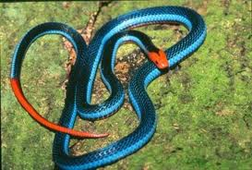
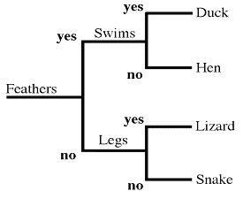
Example…
Notes:
Blue coral snake

Slide 12
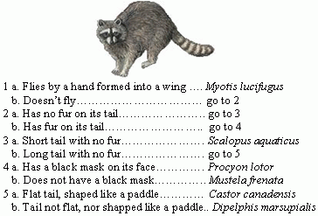
One more example….
Use the picture and the dichotomous key to answer the following question. What is the genus and species of this organism?
A. Procyon lotor
B. Scalopus aquaticus
C. Didelphis marsupialis
D. Castor canadensis

Slide 13
