Slide 1
Bellwork 2.24.14
Please walk in Silently. Stop by the pick up table.
What is a structural adaptation?
What are behavioral adaptations?
How is natural selection related to the idea of “survival of the fittest”?

Slide 2
Agenda
Bellwork
Objective: SWBAT explain how fossil records can be used as evidence of natural selection.
Brainpop
Guided Notes.
  Part 1: Why study fossils?
  Part 2: How are fossils formed?
  Part 3: How do we find the age of fossils?
Independent Work
Homework is due tomorrow.

Slide 3
Brainpop

Slide 4
Outline for Notes
I.) Why study fossils?
  A.)
  B.)
  C.)
  D.)
II.) How are fossils formed?
  A.)
  B.)
  C.)
  D.)
III.) How do we know how old a fossil is?
  A.)

Slide 5
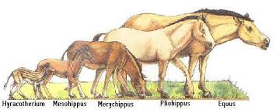
Why do archaeologists study fossils?
Species have evolved or __________ over time
Change

Slide 6
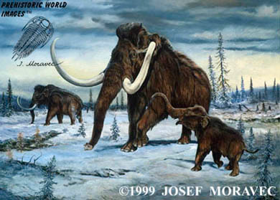
Inform us about past _______________ that species lived in.
Environments

Slide 7
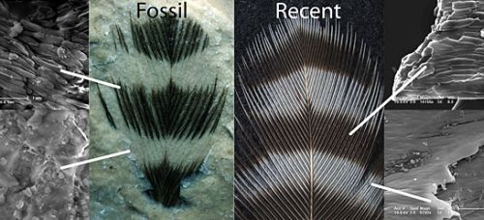
See how different species are _________ to each other.
Similar

Slide 8
Determine the relative or absolute ________ of fossils, which determines the time period(s) in which species lived
age

Slide 9
How do fossils form?
Fossils form in SEDIMENTARY ROCK.
Sedimentary rocks form in layers of minerals.
Both fossils and sedimentary rock require lots of heat and pressure.

Slide 10
5 Types of Fossils:
Molds
Casts
Trace fossils
Petrified fossils
Imprints

Slide 11
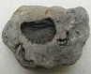
Mold fossils- an empty space is left when an organism is buried in sediment and then decays
Form when an organism dies and falls in a layer of soft sediment.
More sediment falls on top of it and the organisms decays.
If the organism formed an imprint and an empty space, it is called a mold.

Slide 12
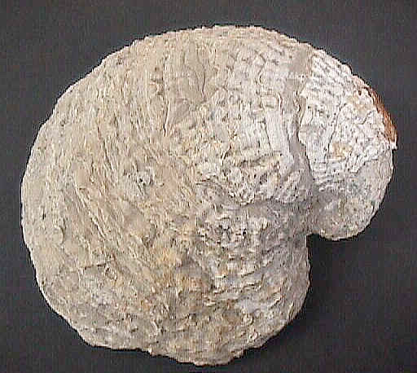
Example of a Mold Fossil

Slide 13
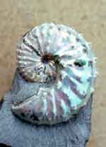
Cast fossils- Minerals in rocks fill a space left by a decayed organism (replica)
If a space in the imprint is filled with minerals when the original animal or plant part dissolved, it is called a cast.
Cast fossil

Slide 14
Example of a Cast Fossil

Slide 15
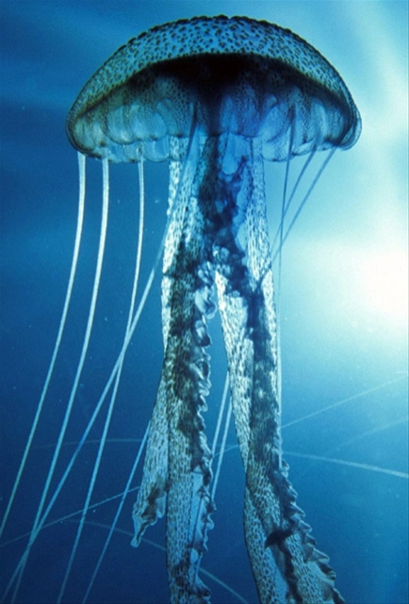
HOT Question: Why do you think scientists have rarely found a fossilized jellyfish?
Answer: They have soft bodies

Slide 16
PowerPoint 5
3. Trace Fossil- Markings left by an animal (footprint, trail, or burrow)
A footprint of an animal
is called a Trace Fossil

Slide 17
Example of a Trace Fossil
www.scsc.k12.ar.us/TuttS/fossil_formation.htm

Slide 18
4. Petrified Fossil- Minerals penetrate and replace the hard parts of an organism (copies)

Slide 19
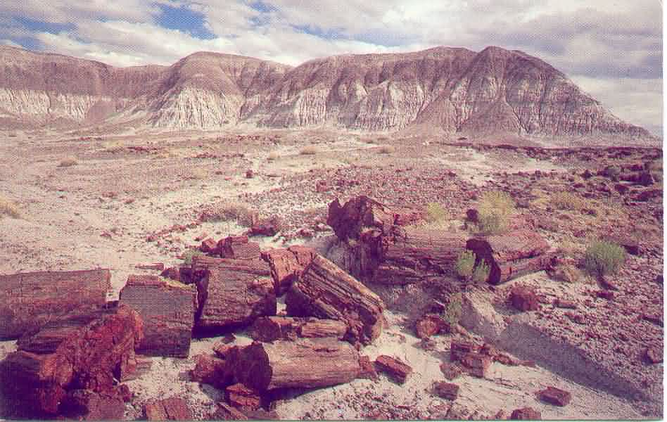
Petrified forest in Arizona

Slide 20
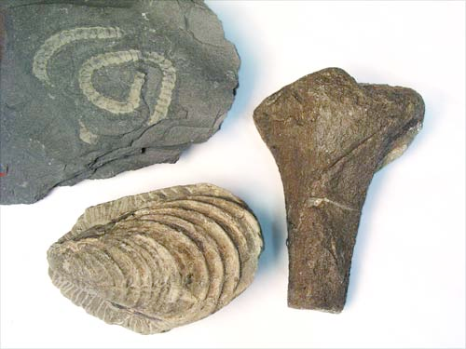
Trace fossil
Petrified
Fossil
Cast

Slide 21
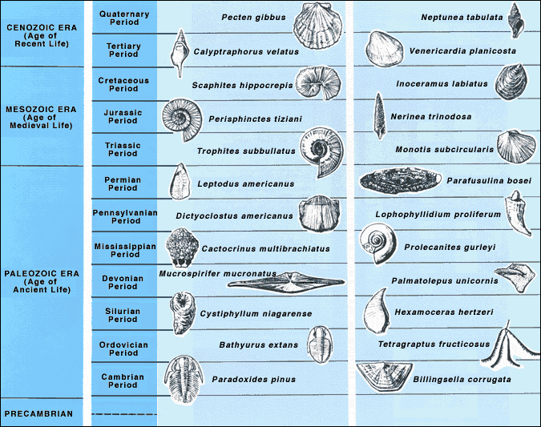
What is this? What could geologist use this for?

Slide 22
Part III: How do we know how old a fossil is?

Slide 23
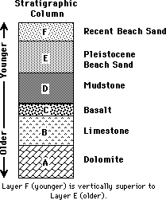
REVIEW: The law of Superposition
In horizontal layers of sedimentary rock, each layer is older than the layer above it and younger than the layer below it.

Slide 24
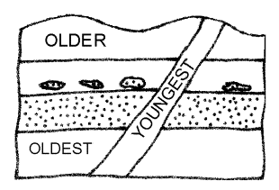
HOT Question!
What is the age of an intrusion igneous rock in relation to the sedimentary rock layers through which it passes?

Slide 25
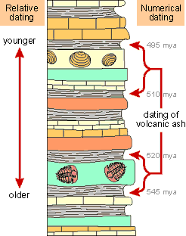
How do we know how old a fossil is?
Relative Dating- uses index fossils to date sediment layers
Absolute Dating- (numerical dating) uses radioactive dating

Slide 26
1. RELATIVE Dating
Index or Guide Fossils
Fossil of species of organisms that were common but only around for a relatively short period of time (they evolved, then became extinct)
These fossils are used to date sediment layers-when we find a rock with one of these index fossils in it – we know the relative time in which that rock was formed.

Slide 27
Determining the ages of rocks using index fossils
When using index fossils for relative dating, scientists study the position of the fossils in the sedimentary rock layers

Slide 28
Index Fossils
1. What is an example of an index fossil?
  Squids
  Dinosaurs
  Trilobites
  Cats
2. If you uncovered a Bathyurus Extans, what time period would any fossil found around it be from?
  Triassic Period
  Ordovician Period
  Tertiary Period
  Paleozoic Era

Slide 29
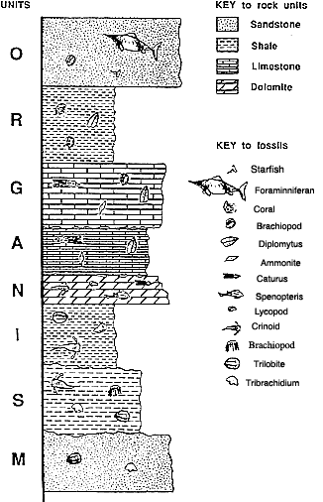
HOT Practice!
An index fossil is a fossil that is found only in one layer of earth and can be used to date layers. What fossils would be good index fossils? Explain why.
What fossils would be bad index fossils? Explain why.
Would a Foraminniferan be older or younger than the spenopteris?

