Slide 1
Bellwork 2.4.14
Please walk in Silently. Stop by the pick up table.
1.) Explain why we would need acids.
2.) What is one way that acids might be harmful to us?
3.) Describe the motion of a solid, liquid, and gas.
Your lab reports were due yesterday.

Slide 2
Agenda
Bellwork
Objective: SWBAT evaluate the role of acids in our natural environment by reading articles and sharing thoughts with their partners. The end result will be a Venn diagram that compares and contrasts the articles.
ANNOUNCMENT! I have uploaded pictures from all of our labs on the website!
Annotate articles
Share with a neighbor

Slide 3
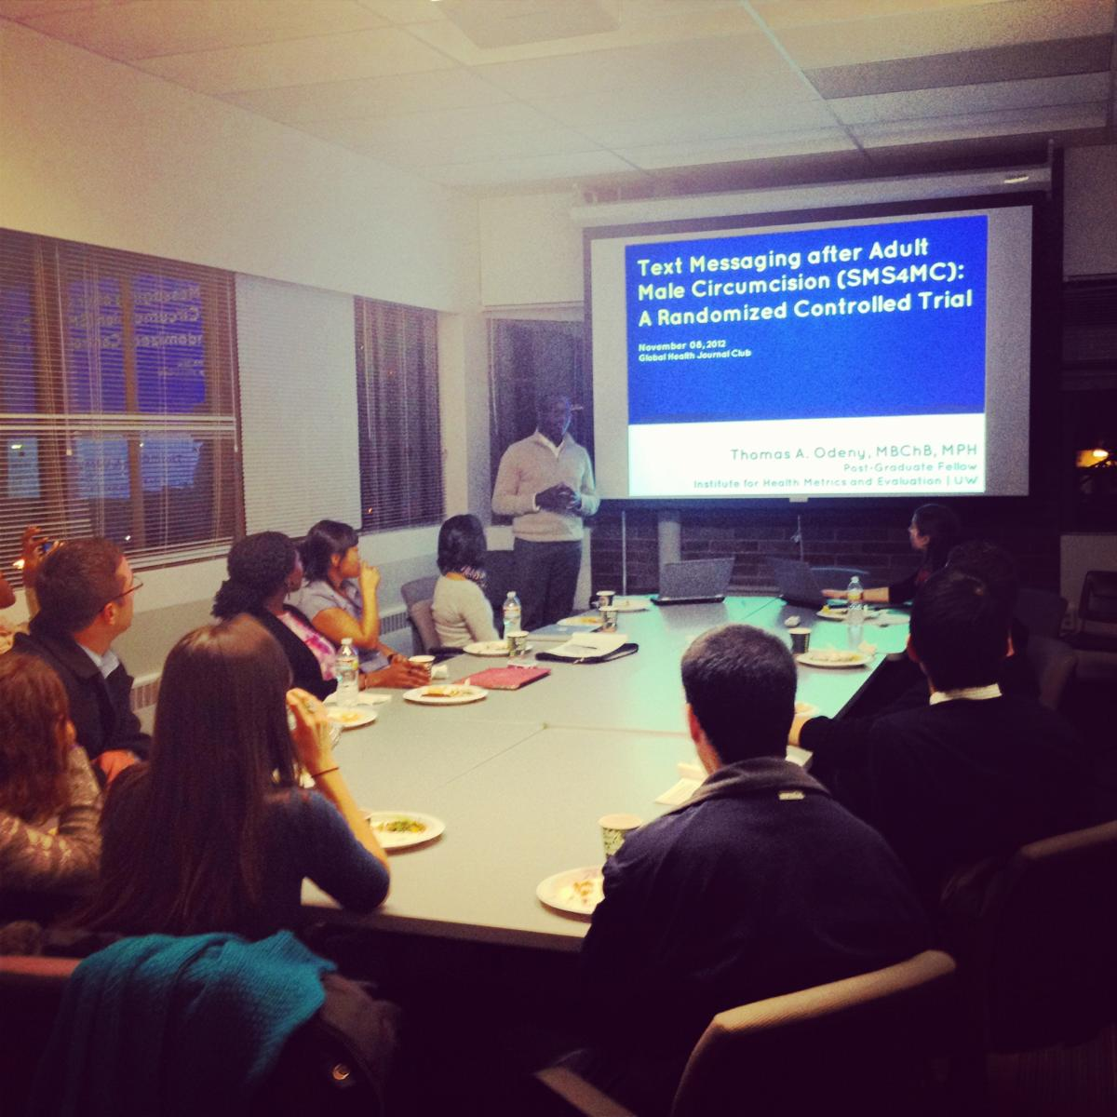
Journal Club!
Notes:
Whether you want to be a doctor, a sociologist, a lawyer, or newscaster there is always research going on. That means that scientists and other professionals are constantly reading other people’s research and writing about their own research to be published and seen by others.

Slide 4
Something I’m proud of!
Notes:
One thing that I am really proud of is this

Slide 5
Do your own Research!
Read the article at your own table.
Popcorn read, and then you can read independently.
Use the Journal Club Symbols to annotate your article.
Using your annotations will better help you answer all of your questions and share during your discussion.
Noise Level: Library Voices
Time: 15 minutes
You must read the article AT LEAST TWICE. Once independently and one with your group

Slide 6
Journal Club Symbols
This is important. Main Idea
Supporting Evidence
I need to look up this word
? I need more information
!!!! I’m surprised! I didn’t know!
This reminds me of… ∞

Slide 7
Pair and Share
This is an opportunity for you to share what you have learned from reading the article and learning what others will share with you about their article.
Work together to compare and contrast the articles by answering the think pair share questions.
Create a Venn Diagram with both partners names on it to turn in at the end of class.

