Slide 1
Bellwork January 13, 2013
Substance | Product or Reactant?
PbBr₂
Pb
Br₂
Substance | Product or Reactant?
C₁₂H₂₂O₁₁
C
H₂O

Slide 2
Agenda
Bellwork
Objective: Students will be able to apply the Law of Conservation of mass in chemical equations to find the missing mass of the reactant and product.
Guided Practice
Independent Practice
EXIT TICKET

Slide 3
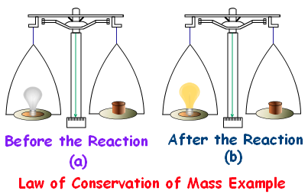
Law of Conservation of Mass

Slide 4
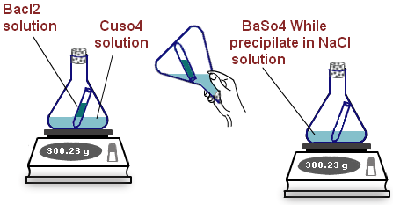

Slide 5
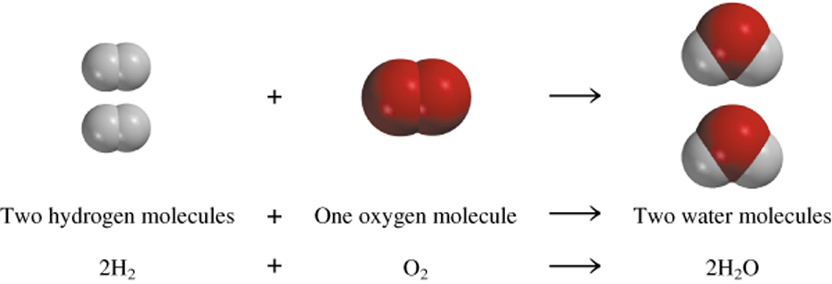
In a chemical reaction
The way atoms are joined is changed…
Atoms are NOT created or destroyed.

Slide 6
Law of Conservation of Mass
You know R.A.P. well know you need
R.E. P.
Based on our demonstration from yesterday, we can conclude.
___________ of ___________ = __________ of_______________
R.eactant E.quals P.roduct
MASS OF REACTANT = MASS OF PRODUCT

Slide 7
Check for Understanding…
If the total mass of the reactants is 88 grams, what is the total mass of the products?
88 grams
If 5 grams of product is produced, what was the mass of the reactants?
5 grams
Always be prepared to answer with the why.
Your answer + because…

Slide 8
Guided Example #1
____ grams reactant L + 2 grams reactant M → 8 grams product N
Steps:
1.) Reactants: L & M; Products: N
2.) Looking for grams of reactant L
3.) X grams L + 2g M = 8 g N
X grams + 2 grams = 8 grams
4.) X=2 grams

Slide 9
Guided Example #2
40 g of calcium reacts with 71 g of chlorine to produce _____ g of calcium chloride.
Reaction: 40 g calcium + 71 g chlorine → X g CaCl
Set up equation: 40g + 71g = Xg
Solve for X!
X= 111g of Calcium chloride

Slide 10
Guided Practice
1.) _____ g of potassium reacts with 20 g of oxygen to produce 50 g of potassium oxide.
Write Equation: X g potassium + 20g oxygen = 50 g K2O
Solve for X: X + 20 = 50
x=30

Slide 11
Guided Practice
2.) 1 grams reactant A + 10 grams reactant B → ______ grams product C
Equation: _____ + _______ = _________
Solve for X:

Slide 12
Guided Practice
3.) 15 g of lithium creates a reaction with _____ g sulfur to produce 45 g of lithium sulfide.
Equation:
Solve for X:

Slide 13
4.) 3 grams reactant W + ____ grams reactant X → 2 grams product Y + 10 grams product Z
Equation:
Solve for X:

Slide 14
Independent Practice

