Slide 1
Bellwork 1. 28.14
Please walk in Silently and begin your bellwork.
1.) Name 3 differences between an acid and a base.
2. ) Name 2 things that acids and bases have in common.
3.) Give 1 example of an acid and 1 example of a base.
ALWAYS WRITE IN COMPLETE SENTENCES

Slide 2
Agenda
Bellwork
Objective: SWBAT classify substances as acids or bases using the pH scale, pH indicator, and litmus paper.
Brainpop
Build your own pH scale

Slide 3
Brainpop

Slide 4
Well, what is pH?
pH is a measure of how many hydronium (H₃0⁺) and hydroxide (OH⁻) ions are in a solution
acid produces hydronium (H₃0⁺) ions
base produces hydroxide ions (OH⁻)
In neutral substances H+ = OH -

Slide 5
What is a pH scale?
A pH scale is used to measure how acidic or how basic a substance is. The pH scale ranges from 0 to 14, with a neutral pH of 7 directly in the middle.

Slide 6
Create your own pH scale
Step 1: pH scale ranges from 0-14.
Number your pH scale from 1 – 14 with 7 in the middle.

Slide 7
Create your own pH scale
Step 2: Label your acids.
Acids have a pH below 7. The lower the pH the stronger the acid.
Strongest Acid!
Acids
Increasing Acidity

Slide 8
Create your own pH scale
Step 3: Label your Bases.
Bases have a pH above 7. The higher the pH the stronger the base.
Strongest Base!
Base
Increasing Basicity

Slide 9
What about pH 7?
Step 4: Label pH 7 Neutral
Neutral substances have a pH of 7.

Slide 10
Does your pH scale look like this?
Strongest Acid
Strongest Base
Increasing Acidity
Increasingly basic

Slide 11
Practice
Which is a stronger acid?
A) pH=4
B) pH=5
Which is a weaker base?
A) pH=10
B) pH=14
Which is a stronger base?
A) pH=12
B) pH=13

Slide 12
Well, how do you find the pH?
There are several ways to find the pH
pH meter
Chemical indicators
Litmus paper
pH paper

Slide 13
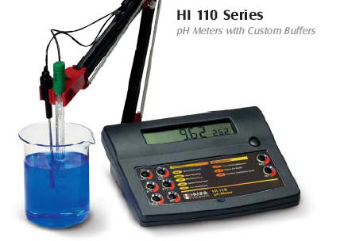
pH meter
pH meter uses electrodes to measure the ions and converts them to pH.

Slide 14
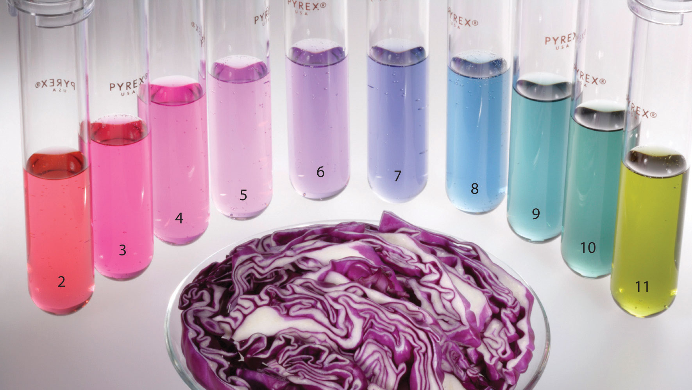
Chemical Indicators
Chemical Indicators are substances used to measure or indicate the pH of a substance.

Slide 15
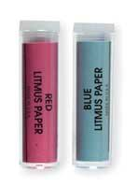
Litmus Paper
Litmus Paper
Red Litmus Paper
Turns blue when dipped in a base
Stays red if dipped in acid or neutral.
Blue Litmus Paper
Turns red when dipped in an acid
Stays blue if dipped in base or neutral

Slide 16
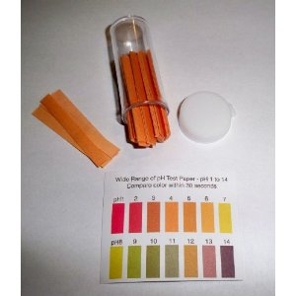
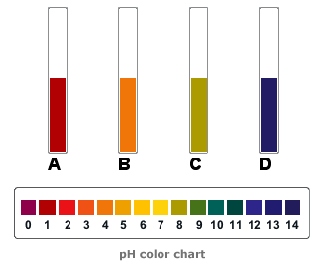
pH Paper
pH paper changes color to indicate the pH of a substance.
What is the pH of A? Acid or base?
What is the ph of B? Acid or Base?
What is the pH of C? Acid or Base?
What is the pH of D? Acid or base?

Slide 17
Check for Understanding
A solution with a pH of 4 is
an acid
a base
neutral

Slide 18
Check for Understanding
2. A solution with a pH of 8 is
an acid
a base
neutral

Slide 19
Check for Understanding
An acidic solution will…
turn red litmus blue
turn blue litmus red
None of the above

Slide 20
Check for Understanding
A solution with a pH of 7 is
an acid
a base
neutral

Slide 21
Check for Understanding
The pH of a strong base would be around…
8-9
10-11
12-14

